Slide 1
Unsupervised Learning
L.N. Brice

Slide 2
What is unsupervised learning?
“find underlying structures from unlabelled data.”

Slide 3
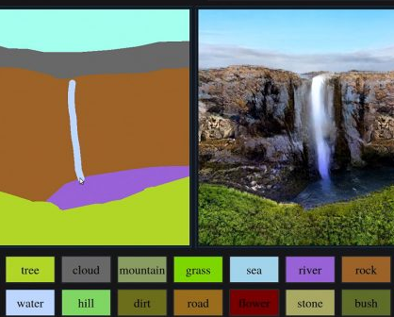
The most used algorithms
Clustering
K-Means
Spectral
DBSCAN
Anomaly detection
Local Outlier Factor
Neural Network
Autoencoder
Generative Adversarial Networks (GAN’s)

Slide 4
Clustering Algorithms
“How many clusters do i have?”

Slide 5
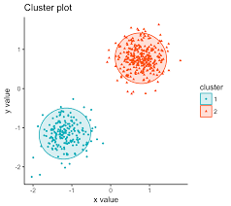
Clustering
What is a cluster?
Group of entities or events sharing similar attributes.
What is clustering?
The process of applying machine learning algorithms for automatic discovery of clusters.

Slide 6
K-Means

Slide 7
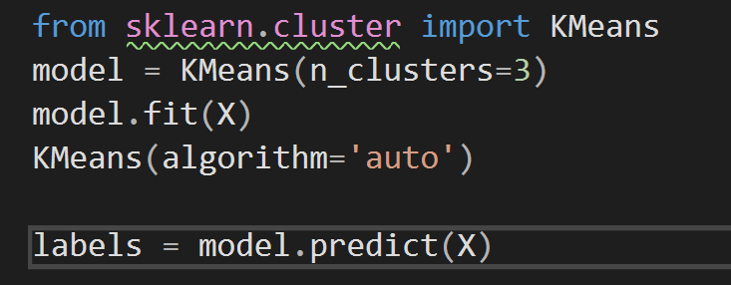
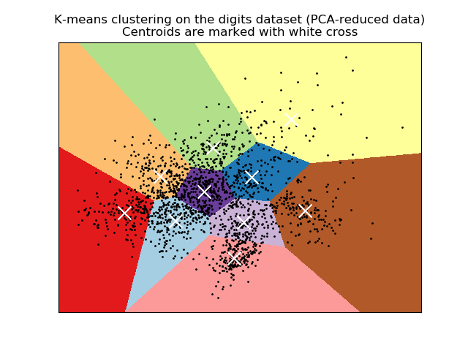
Clustering • K-means
You need to specify the number of clusters KMeans should discover.
KMeans can only discover linear boundary.

Slide 8
How Many Clusters?
“Determining The Optimal Number Of Clusters”

Slide 9
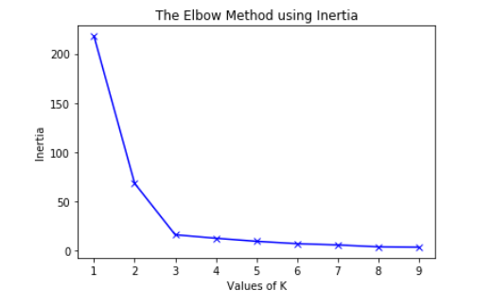
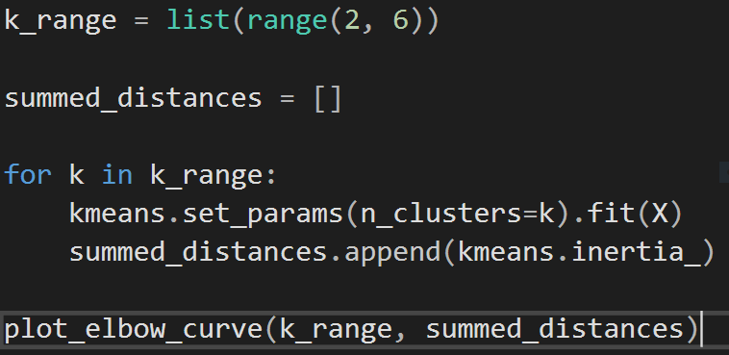
K-means • How many clusters?
Elbow Method:

Slide 10
Spectral

Slide 11
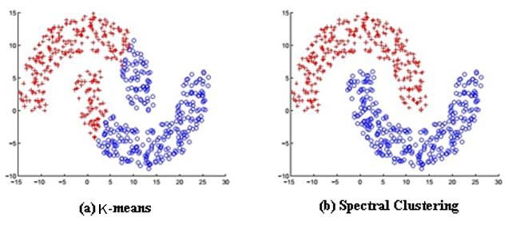
Clustering • Spectral
You need to specify the number of clusters Spectral should discover.
Spectral can discover linear & non-linear boundary.

Slide 12
Density-based spatial clustering of applications with noise (DSCAN)

Slide 13
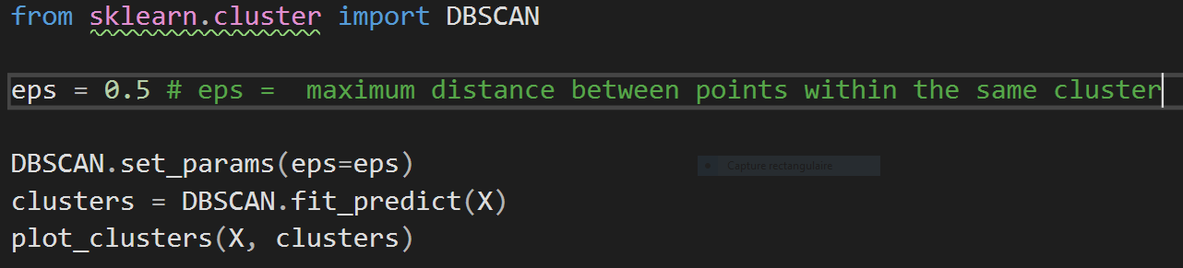
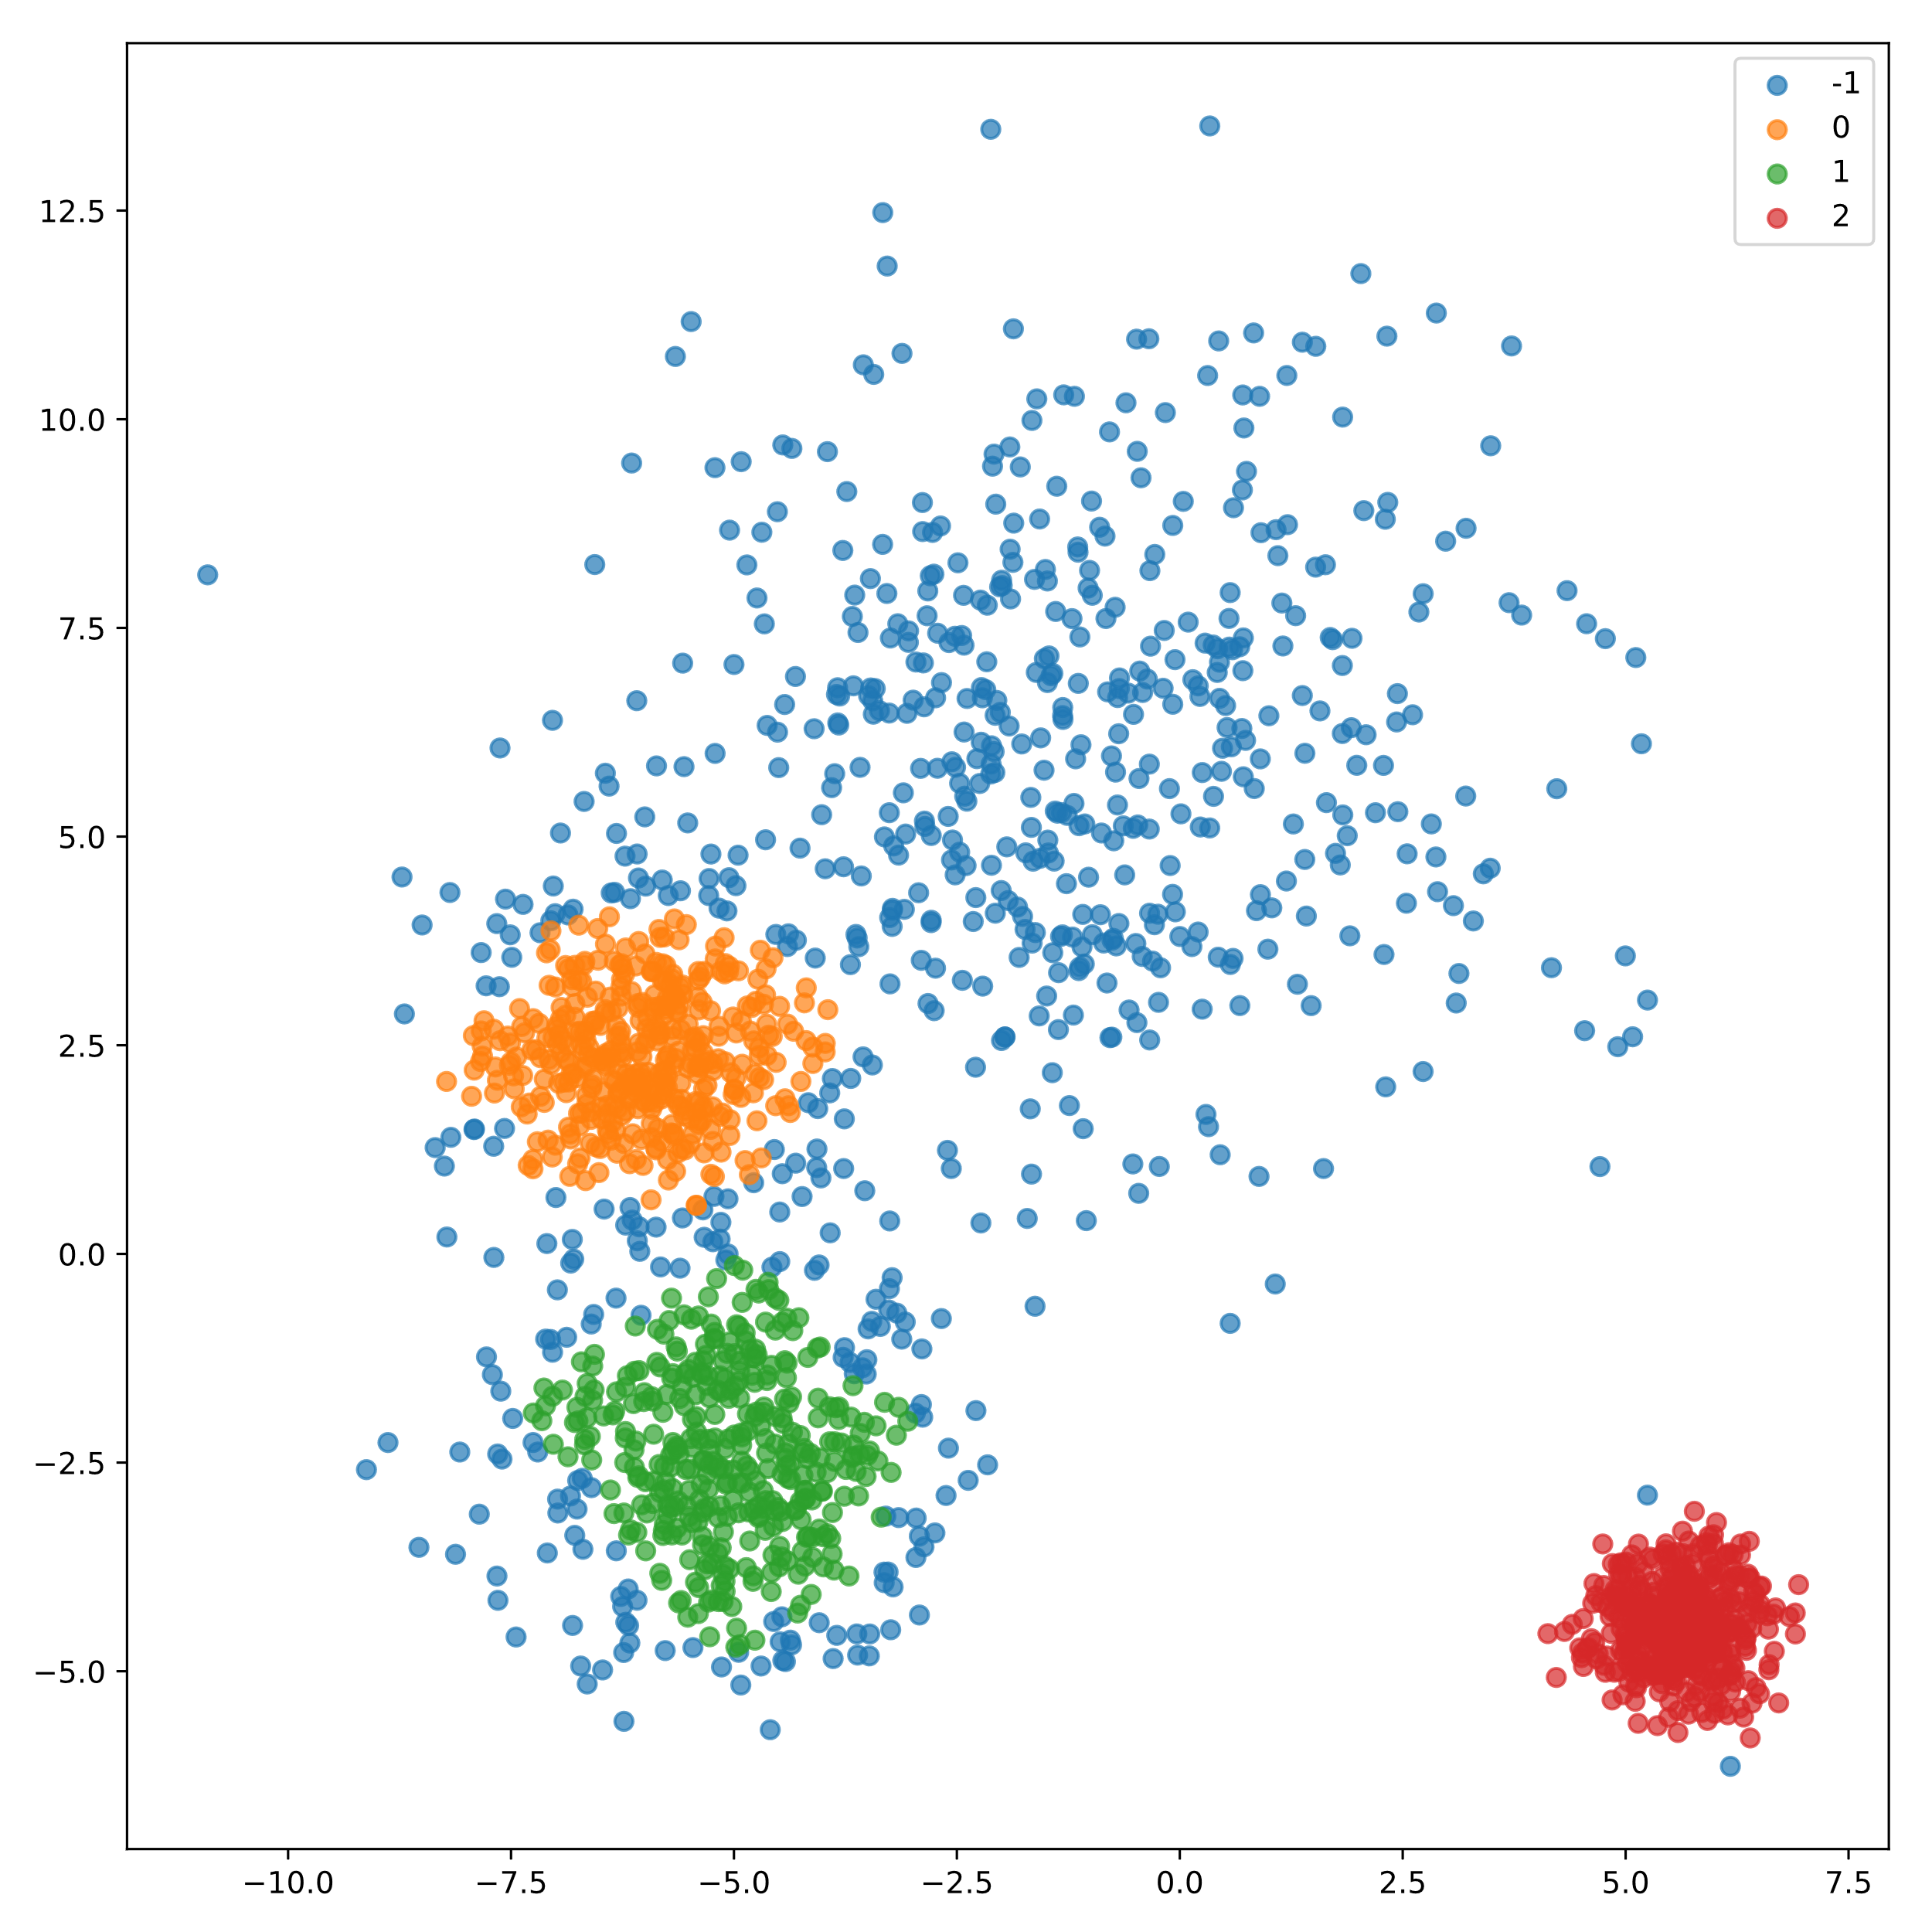
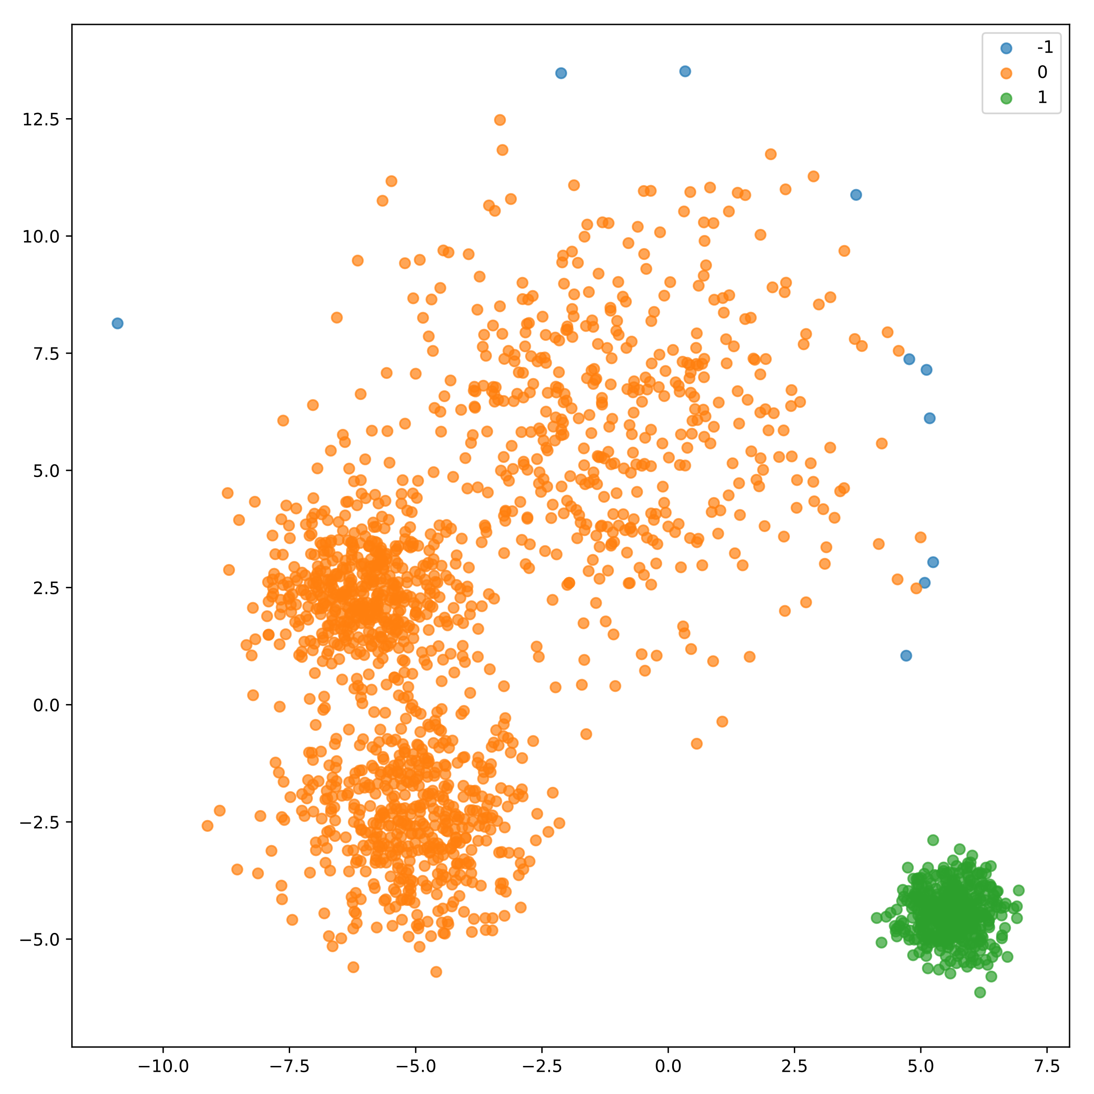
Clustering • DBSCAN
DBSCAN can discover the number of clusters by itself.
He can find non-linear boundaries.
Some "points" may not belong to a cluster.
DBSCAN is not able to manage clusters of different densities.

Slide 14
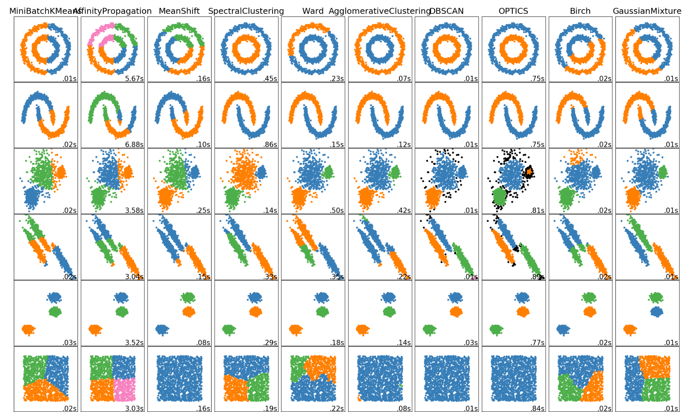
Comparison between different clustering algorithms
https://scikit-learn.org/stable/auto_examples/cluster/plot_cluster_comparison.html

Slide 15
Neural Networks
How Neural networks can learn with unlabeled data?

Slide 16
Overview Of Neural Networks in Unsupervised Learning
AutoEncoder
GAN's

Slide 17
AutoEncoder
« encode data to learn patterns »

Slide 18
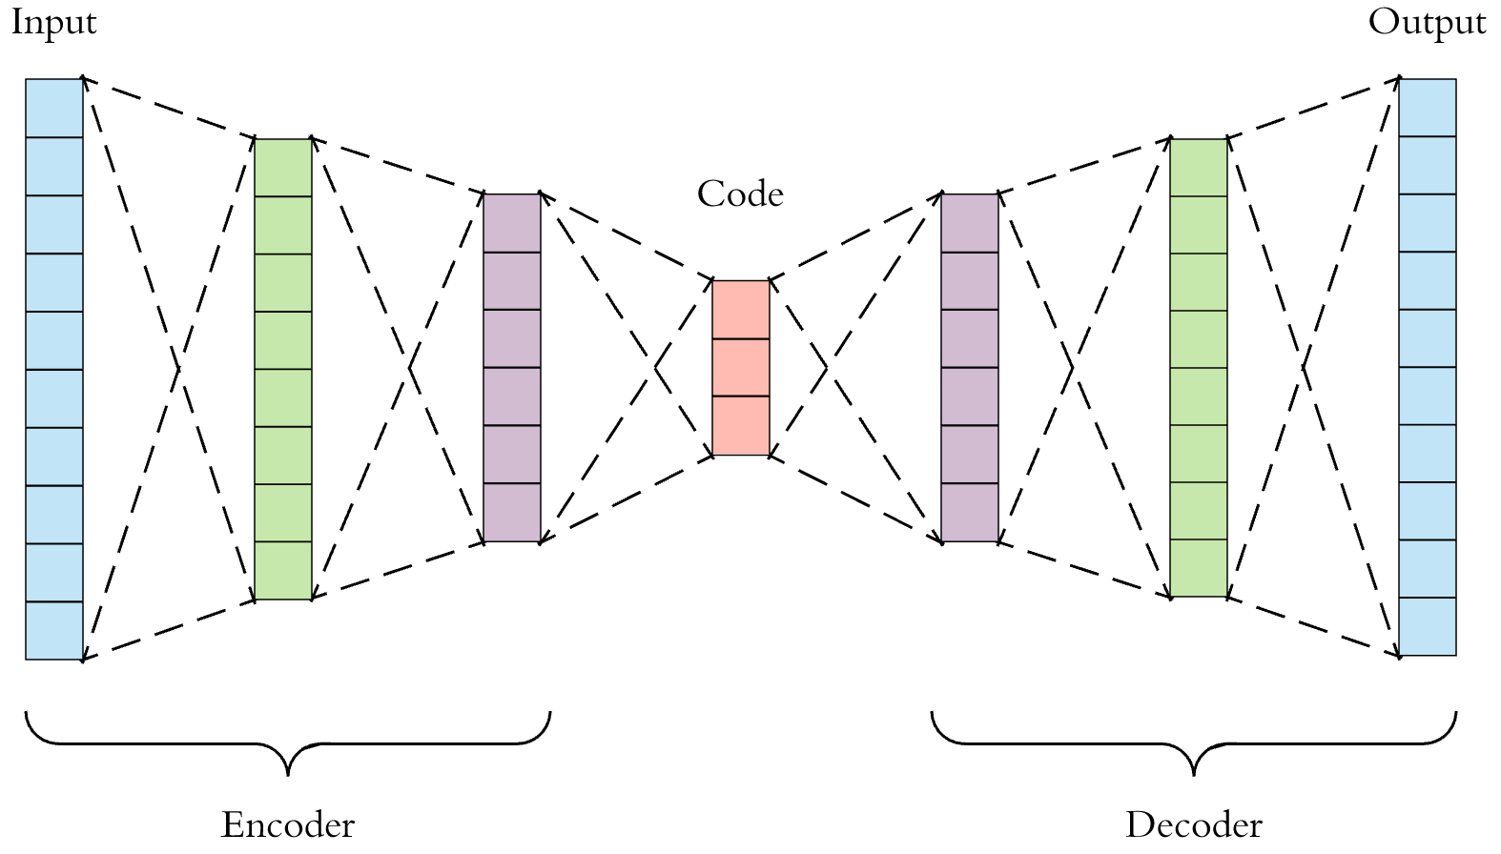
AutoEncoder • Definitions

Slide 19
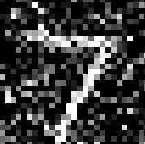

AutoEncoder • What is it?
The objective of an auto-encoder is to learn a representation (encoding) of a data set, generally with the goal of reducing the size of this set.
Use case:
Denoise an image
Detection of anomalies
Dimension reduction
Variational Autoencoders ()

Slide 20
AutoEncoder • How does it work?
Encoder
Decoder

Slide 21
AutoEncoder • How can we train it?
Encoder
Decoder
= OR ≠

Slide 22
Generative Adversarial Networks (GAN)
« History between two neural networks:
- does this image seem correct to you?
No. This image is not realistic.
Ok. I'll do it again. »

Slide 23
GAN • Definitions
Generator: It’s the neural network who create a picture, molecule model, for example.
Discriminator: It’s the neural network who say if the thing created by the Generator is correct or not. Evaluates them for authenticity; i.e. the discriminator decides whether each instance of data that it reviews belongs to the actual training dataset or not.
NN: Neural Network

Slide 24

GAN • What is it?
The objective is to generate images with a high degree of realism.
Use case:
Nvidia GauGAN
Research:
Find new/best molecule arrangement
Generate paintings / Fonts

Slide 25
GAN • How does it work?
Dataset
“What do you think of this image?”
Neural network 1
Neural network 2
No
Does this image match the dataset?
Yes
New Image

Slide 26
GAN • How can we train it?
GAN’s are train with alternative way:
The discriminator trains for one or more epochs
The generator trains for one or more epochs
Repeat steps 1 and 2
Every time the discriminator or the generator are in training phase, the other NN stay constant

Slide 27
“If machine learning is a cake, then unsupervized learning is the actual cake, supervized learning is the icing, and reinforcement learning is the cherry on the top.”
- Yann Lecun at Neural Information Processing Systems 2016

Slide 28
Questions?

